Slide 1

A Meta-Analysis of the Impact of Monensin in Lactating Dairy Cattle. Part 2. Production Effects
김민석
환경과 영양

Slide 2
CONTENTS
01
Introduction
Monensin
02
Meterial
Search engine, Keyword, Data set
03
Method
Data for meta-analysis
04
Result
Table & Forest plot
05
Conclutions

Slide 3
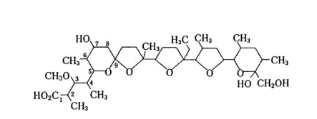
MONENSIN
Monensin is a carboxylic polyether ionophore provided to cattle, orally, as a sodium salt.
Ionophores modify the transport of ions across bacterial cell walls and selectively inhibit
gram-positive bacteria rather than gram-negative bacteria because of differences in
bacterial cell wall structure.

Slide 4


Materials
검색엔진 : Pubmed, Agricola, CAB, Google Scholar
키워드 : ‘monensin and cattle’ 또는 ‘monensin and cow’
데이터 셋 : 36개 의 논문
분석 프로그램 : STATA s/w (Intercooled Stata V. 9.0, College Station, TX)

Slide 5
Method
분석 자료
Monensin dose(mg/d)
Form of monensin (Topdress, CRC, TMR)
Total cows
Trial sites
Diet type(Component, Pasture, TMR)

Slide 6
Method
분석 자료
DMI => 건물 섭취량
milk yield => 우유 생산량
milk production efficiency => 우유 생산 효율성
milk fat percentage => 유지방 비율
milk fat yield => 유지방 수율
milk protein percentage => 유단백 비율
milk protein yield => 유단백 수율
milk lactose percentage => 유당 비율
BCS => Body condition score
BW change => 체중 변화
milk fatty acid profile => 유지방산 프로필(next page)

Slide 7
Method
milk fatty acid profile
C6:0 : Hexanoic acid
C8:0 : Caprylic acid
C10:0 : Decanoic acid
C12:0 : Lauric acid
C14:0 : Myristic acid
C16:0 : Palmitic acid
C18:0 : Stearic acid
C18:1 : Oleic acid
Trans C18:1
C18:2 : Linoleic acid
CLA : Conjugated Linoleic Acid
C18:3 : Linolenic acid

Slide 8
Result
Table 1. Summary of papers used for meta-analysis of production effects of monensin in lactating dairy cow
Table 2. Summary of effect size estimates of monensin on production in lactating dairy cows derived from meta-analysis
Table 3. Effect size estimates of monensin on milk fatty acid (FA) parameters in lactating dairy cows derived from meta-analysis

Slide 9
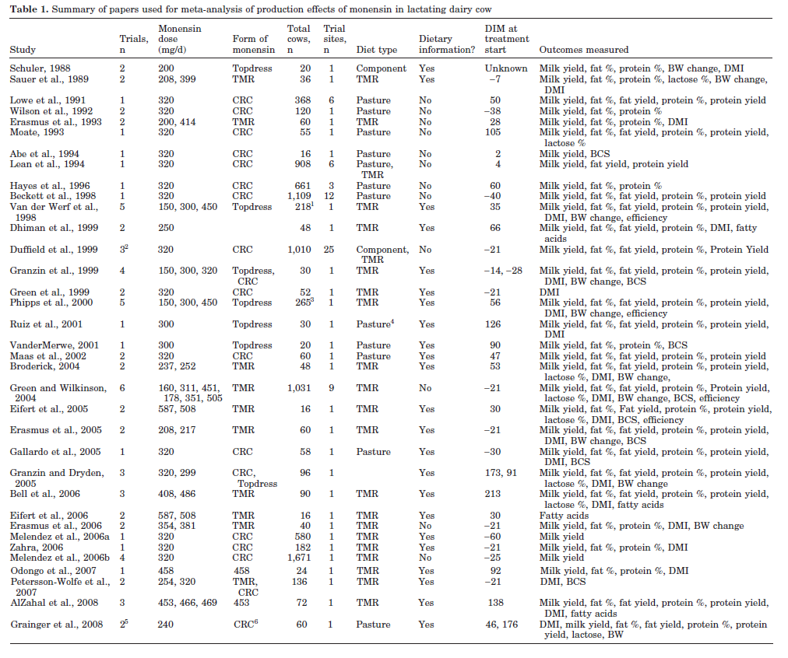
Result

Slide 10
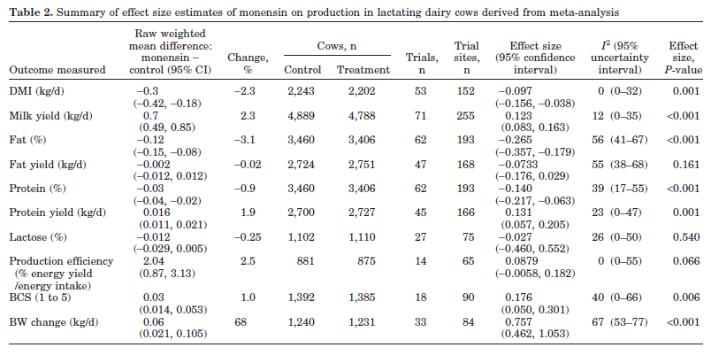
Result

Slide 11
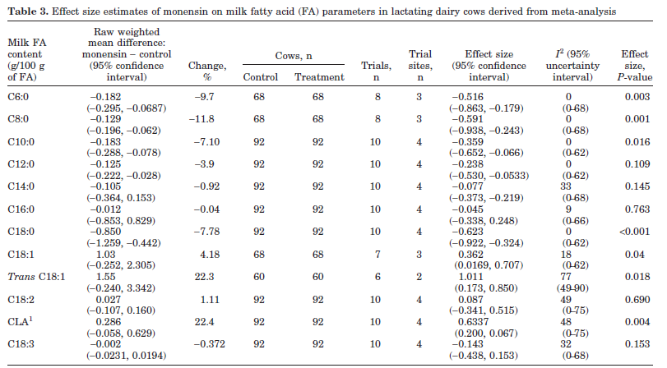
Result

Slide 12
Result
Figure 1. Forest plot of the effect of monensin on DMI in lactating dairy cows
Figure 2. Forest plot of the effect of monensin on milk yield in lactating dairy cows

Slide 13
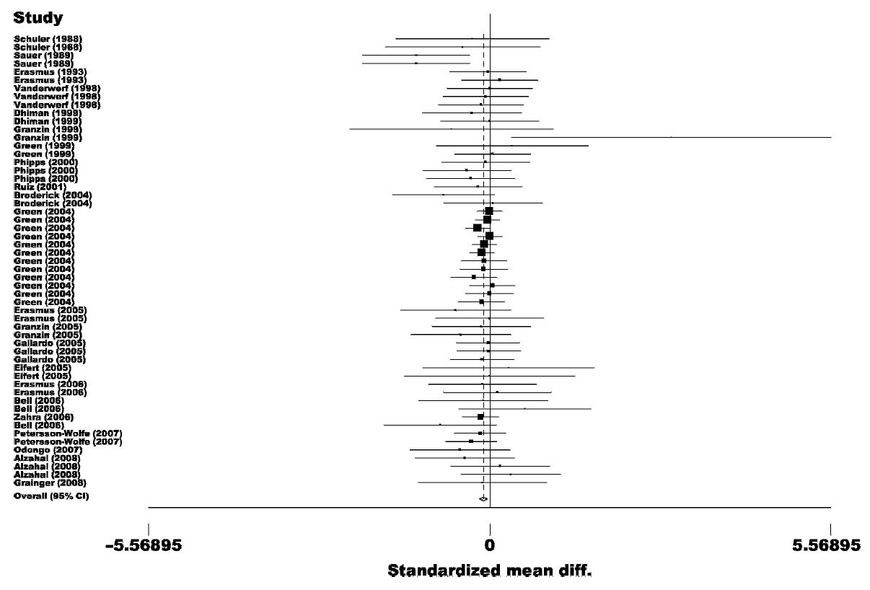
Result

Slide 14
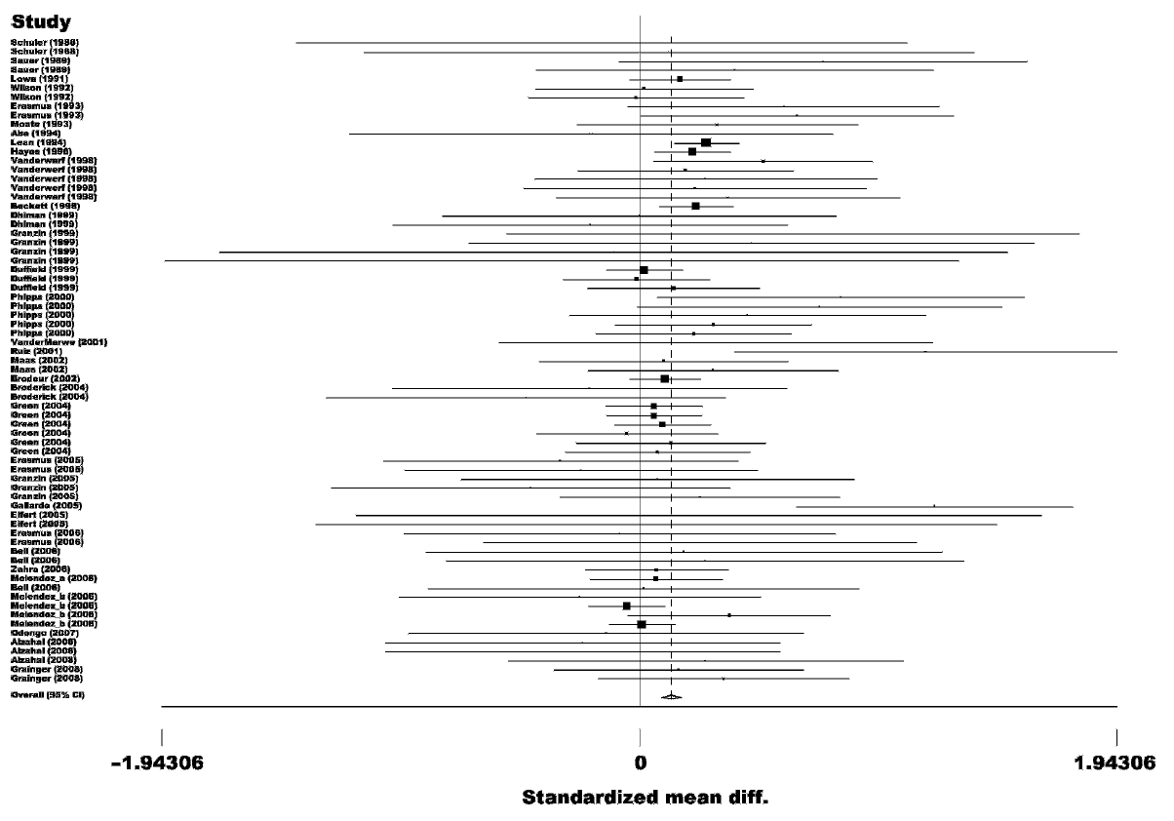
Result

Slide 15
Result
Figure 3-A. Forest plot of the effect of monensin on milk fat (%) in lactating dairy cows
Figure 3-B. Forest plot of the effect of monensin on milk fat yield (kg/d) in lactating dairy cows

Slide 16
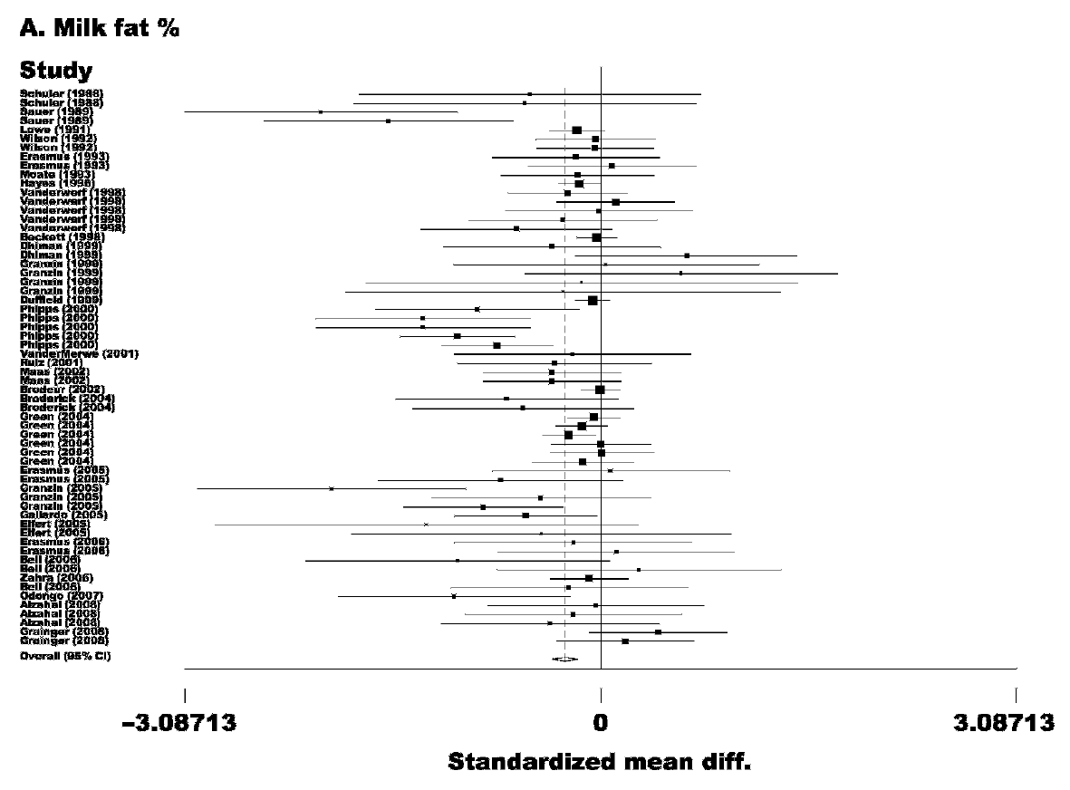
Result

Slide 17
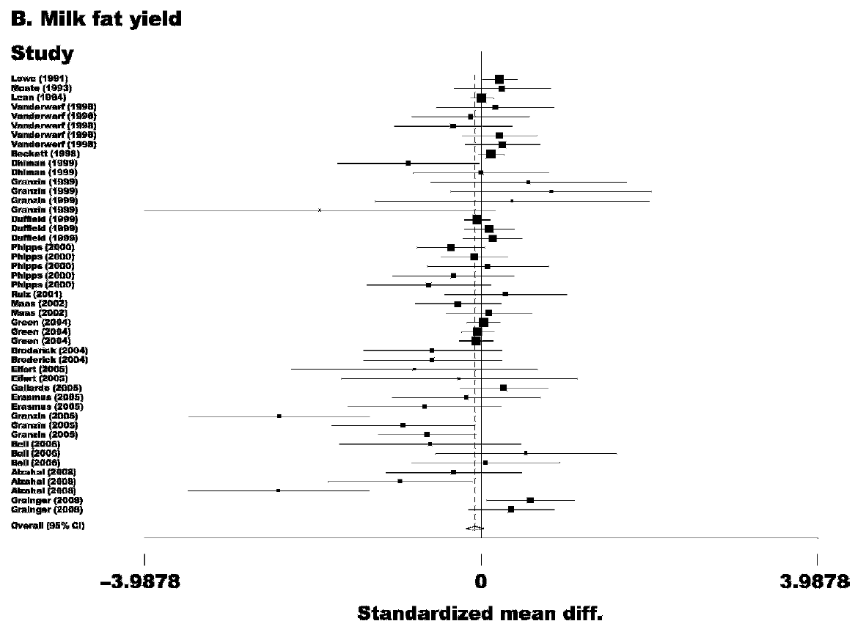
Result

Slide 18
Result
Figure 4-A. Forest plot of the effect of monensin on milk protein (%) in lactating dairy cows
Figure 4-B. Forest plot of the effect of monensin on milk protein yield (kg/d) in lactating dairy cows

Slide 19
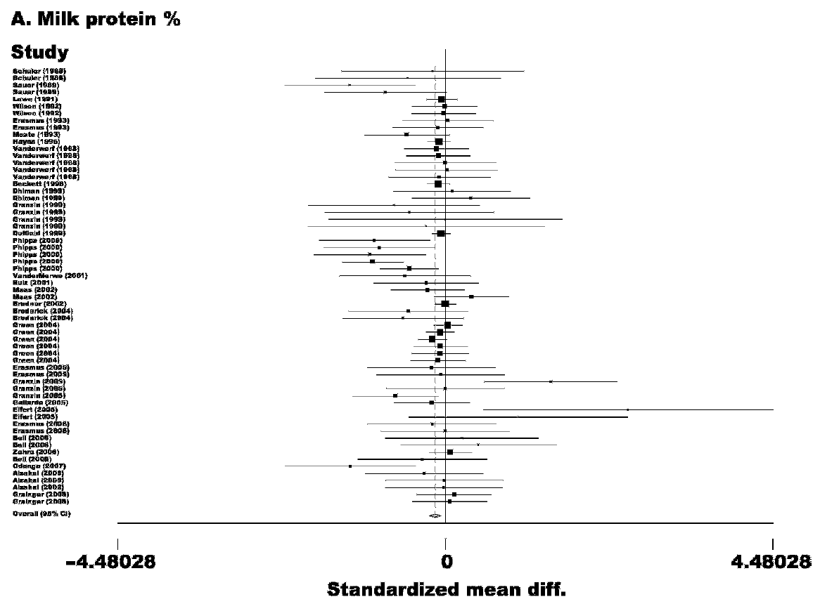
Result

Slide 20
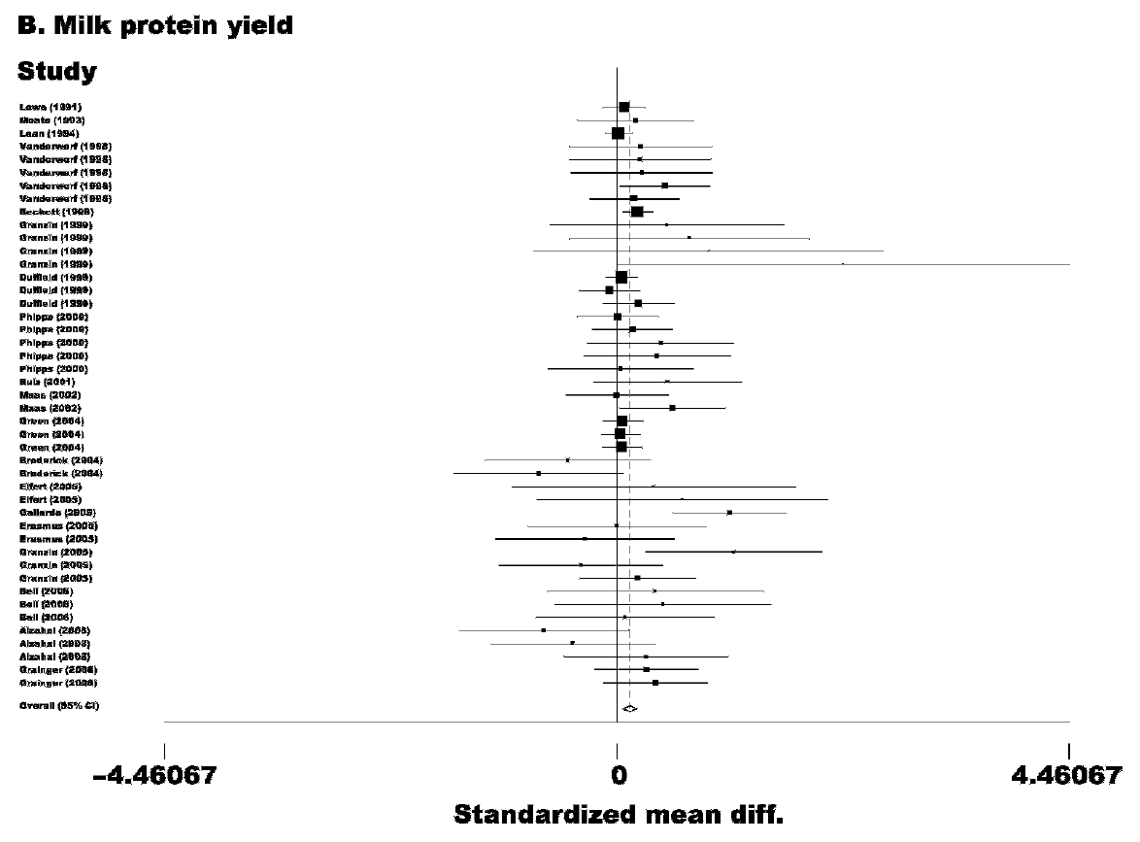
Result

Slide 21
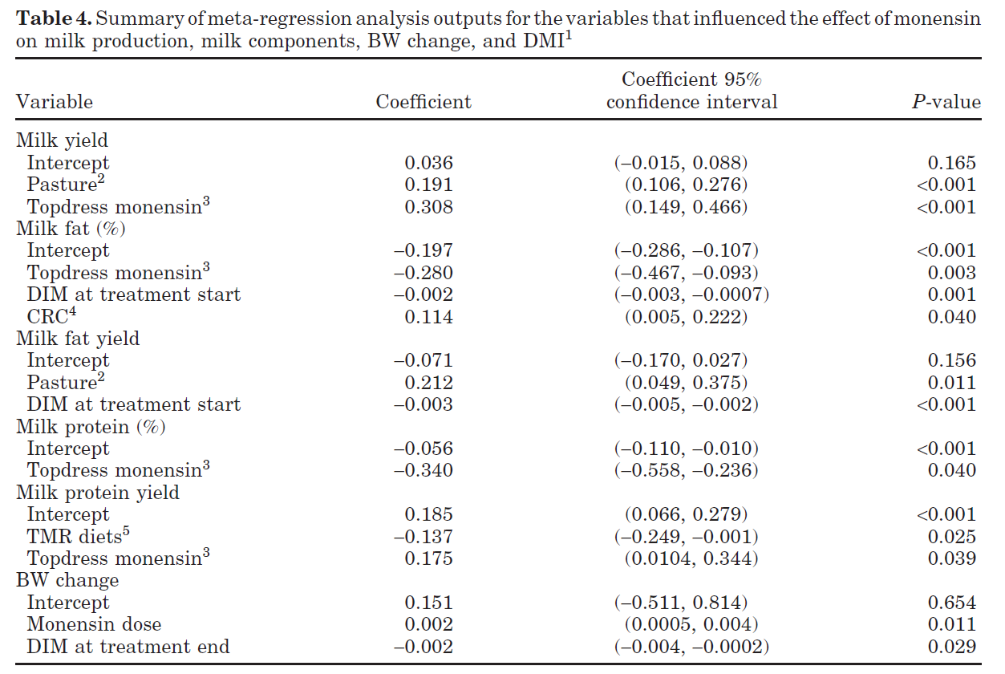
Result

Slide 22
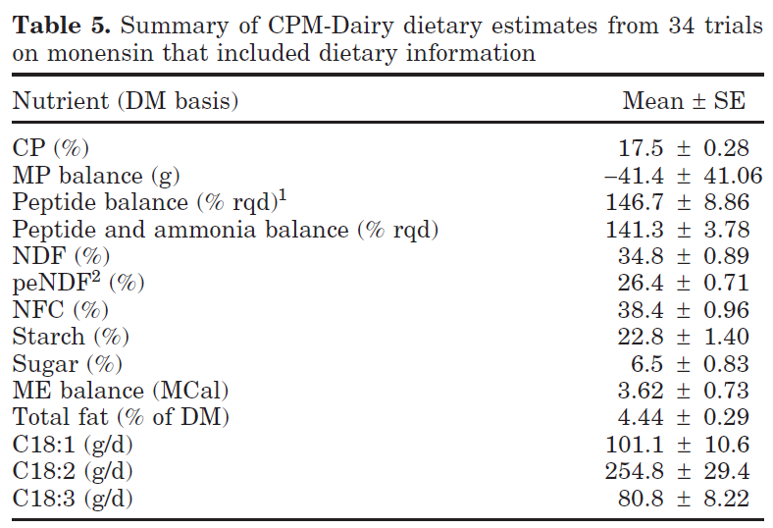
Result

Slide 23
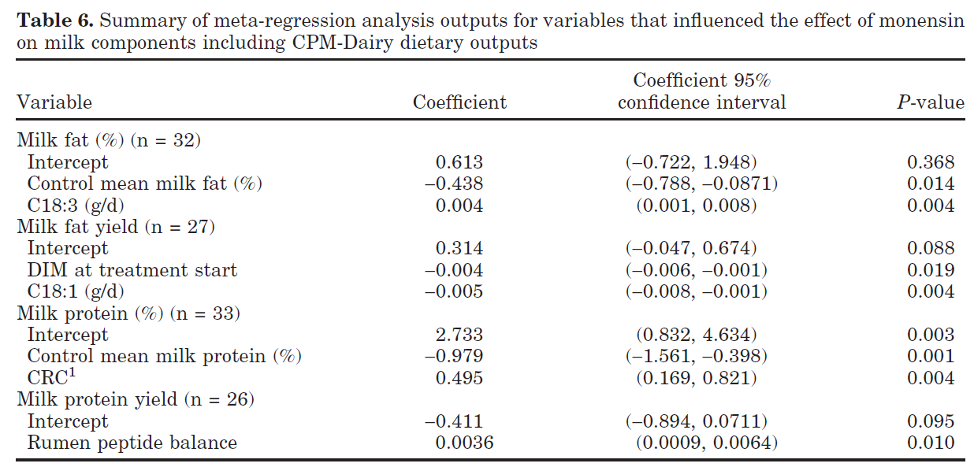
Result

Slide 24
Conclusions
젖소 사료에 Monensin을 급여한 결과
- 우유 생산량이 증가하고 DMI가 감소하며 우유 생산 효율이 향상
- 유단백과 유지방 산출량에 대한 영향은 이질적(사료에 의존)
- 사료에서 불포화지방산을 많이 섭취하면 유지방 총량이 감소
- 반추위 peptide 농도가 약 140%를 초과 하면 유단백 수율 증가
- 조사료 기반 사료와 Monensin이 드레싱된 사료는 Monensin 성분 반응
에 긍정적인 영향을 줌
- BCS와 BW 증가에 미약하게 영향을 줌
(수유 단계와 급여량에 따라 달라진다.)
- Monensin은 우유에서 CLA의 비율을 증가시켰다.

Slide 25
THANK YOU
Yesform.com contribute not only to the forms & documents but also success vision through business consultation and the whole heart companionship.

